Slide 1

Machine Learning Project

Slide 2
Team 9

Slide 3
Who’s presenting?
Rohith Kumar Jayana (IndServ21a047)
Atmuri Venkata Sai Raghunath (IndServ21a046)
Giri Ratna Sai Gummadi (IndServ21a048)
MANAGE PROFILES

Slide 4

GROUP 9
HOME
TV SHOWS
MOVIES
MY LIST
Movie Recommendation System
This content based recommendation system recommends movies similar to movie user searches and analyses sentiments on reviews given to the movie.
The missing is filled by using TMDB api and web scraping.
PLAY
i MORE INFO

Slide 5
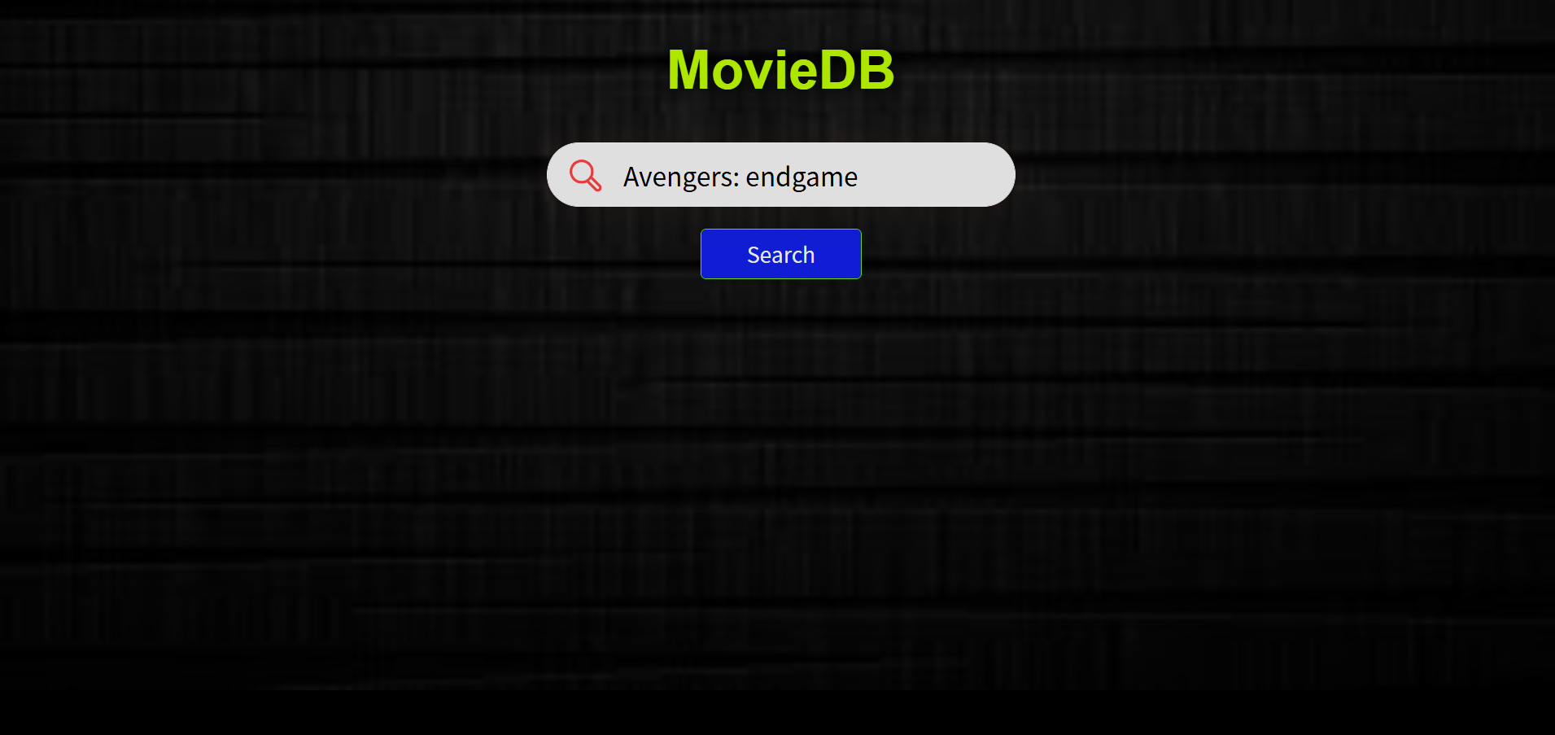
GROUP 9
Overview
The movie recommendation system shows similar type of movies based on search results and displays them.
It also analyses reviews given to the movie into good or bad reviews.
It also has video embed to play trailer of selected movie.
It also displays top cast of a particular movie and also shows movie name suggestions while searching.
There is also a mailing feature present which mails user list of recommended movies of selected genre.
2021
OVERVIEW RESOURCES WEBAPP ARCHITECTURE
Notes:
Creative Commons Attribution-NonCommercial-ShareAlike 4.0 International
EdTechPicks.org 2019-11-02

Slide 6
GROUP 9
Datasets and Modules
Datasets:
Modules and Dependencies
Other Scripts:
IMDB 5000 Movie
The Movies Dataset
2018 movies
2019 movies
2020-21 movies
Flask, gunicorn
Jinja2, MarkupSafe
Werkzeug, numpy
Scipy, nltk
scikit-learn, pandas
Beautifulsoup4, jsonschema
Tmdbv3api, lxml
Urllib3, requests
pickleshare
Bootstrap, Mail, Popper, JQuery
OVERVIEW RESOURCES WEBAPP ARCHITECTURE
Notes:
Creative Commons Attribution-NonCommercial-ShareAlike 4.0 International
EdTechPicks.org 2019-11-02

Slide 7
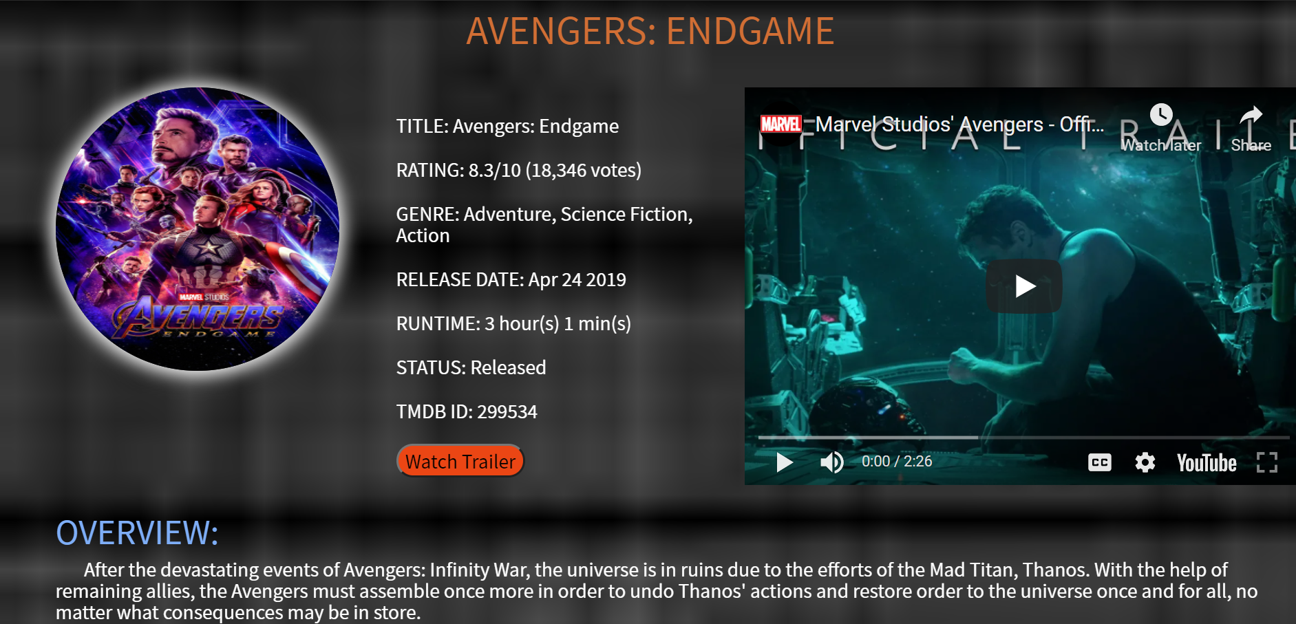
GROUP 9
OVERVIEW RESOURCES WEBAPP DETAILS
Notes:
Creative Commons Attribution-NonCommercial-ShareAlike 4.0 International
EdTechPicks.org 2019-11-02

Slide 8
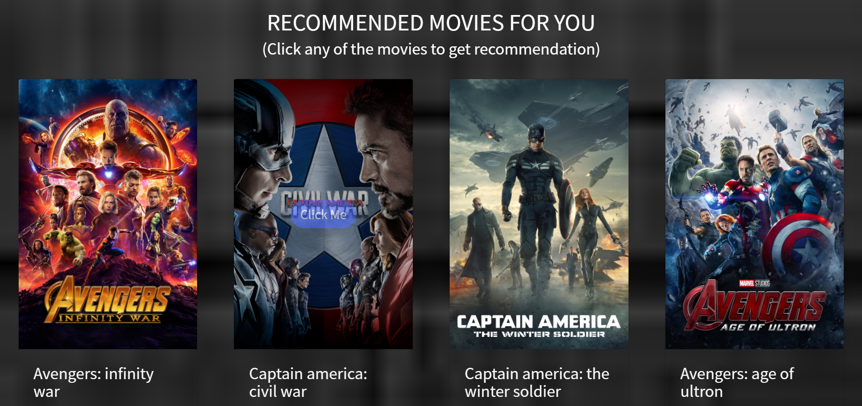
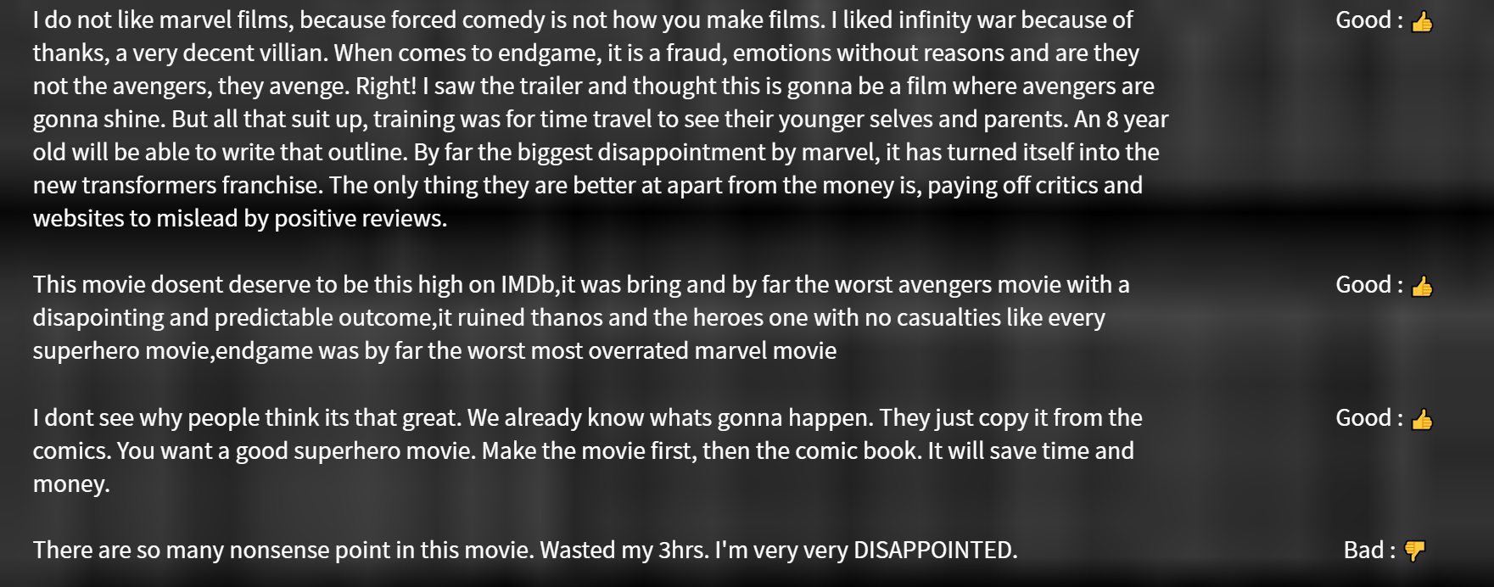
Main Concepts
Cosine Similarity (for finding similar type of movies)
Multinomial Naïve Bayes (for analyzing reviews of movie)

Slide 9
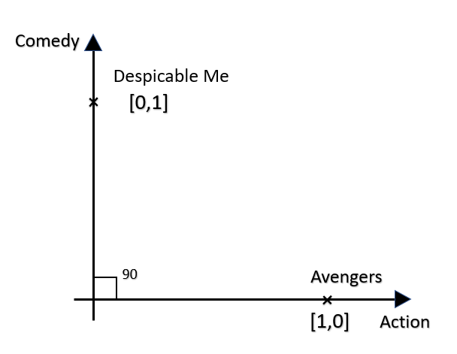
What is cosine similarity?
Cosine similarity measures the similarity between two vectors by calculating the cosine of the angle between the two vectors.
Cosine similarity is one of the most widely used and powerful similarity measure in Data Science. It is used in multiple applications such as finding similar documents in NLP, information retrieval, finding similar sequence to a DNA in bioinformatics, detecting plagiarism and may more.

Slide 10
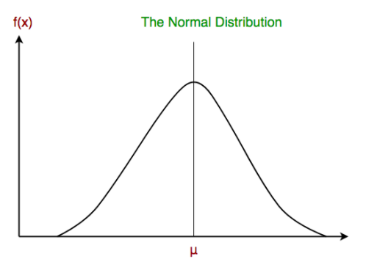
Multinominal Naive Bayes
Multinomial Naive Bayes algorithm is a probabilistic learning method that is mostly used in Natural Language Processing (NLP). The algorithm is based on the Bayes theorem and predicts the tag of a text such as a piece of email or newspaper article. It calculates the probability of each tag for a given sample and then gives the tag with the highest probability as output.
Naive Bayes model is easy to build and particularly useful for very large data sets. Along with simplicity, Naive Bayes is known to outperform even highly sophisticated classification methods.

Slide 11
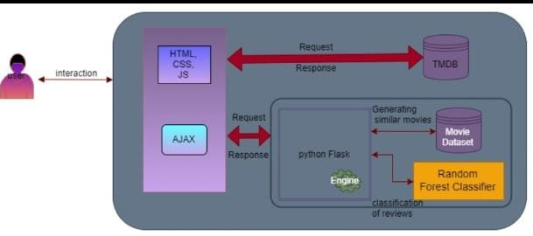
GROUP 9
Architecture
OVERVIEW RESOURCES WEBAPP ARCHITECTURE
Notes:
Creative Commons Attribution-NonCommercial-ShareAlike 4.0 International
EdTechPicks.org 2019-11-02

Slide 12
GROUP 9
Architecture
When user search for a movie, two requests are sent from client side, one through TMDB API and other through flask to our datasets.
The datasets are pre-processed and missing details are filled by response from the TMDB API, missing details in datasets may include actorname,genre etc.
This pre-processing allows the model to autocomplete the movie name when user is typing, we use movie titles from final pre-processed datasets and use regex to display the titles. Example, if we type endgame we suggestion Avengers: Endgame.
OVERVIEW RESOURCES WEBAPP ARCHITECTURE
Notes:
Creative Commons Attribution-NonCommercial-ShareAlike 4.0 International
EdTechPicks.org 2019-11-02

Slide 13
GROUP 9
Architecture
We then find similar movies with respect to movie searched by client using cosine similarity and sends response through flask to HTML page.
We take user reviews from the TMDB api and do analysis where it is positive or negative using Multinomial Naïve Bayes. We have list of review keywords which positive and negative reviews and we find the occurrence of these words in the movie reviews and classify as good and bad.
Along with those responses we also embed the trailer video of that movie.
OVERVIEW RESOURCES WEBAPP ARCHITECTURE
Notes:
Creative Commons Attribution-NonCommercial-ShareAlike 4.0 International
EdTechPicks.org 2019-11-02

Slide 14
Thank You

